Slide 1
Kreyol 101
Basics of Kreyol Language of the Haitian culture

Slide 2
ORTHOLOGY
Haitian Language has a simple orthology in which spelling follows pronunciation.
Haitian Creole is composed of the following 32 sounds : a, an, b, ch, d, e ,è, en, f, g, h, i, j, k, l, m, n, ng, o, ò, on, ou, oun, p, r, s, t, ui, v, w, y, z.
The following letters: c, q, u and x, are not used in common language. Letter k is to be used for the sounds of letters c and q, and letter u is always associated with another letter: ou, oun, ui.

Slide 3
How to greet your fellow Haitian
Basic greetings English Translations
Bon jou Good Morning
Bon swa Good Night
Bon apre midi Good Afternoon
Q: Komon ou ye? How are you?
A: Mwen pa pli mal. I am not bad.
Q: E ou menm? And you?
A: Mwen bien. I’m good.
Q: Ki gen ou rele ? What is your name?
A: Mwen rele (your name) My name is…

Slide 4
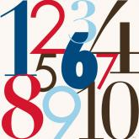
Numbers (Numero)
0-zero
1-un/youn
2-deux/de
3-trois/twa
4-quartre/kat
5-cinque/senk
6-six/sis
7-septre/set
8-huit/uit
9-neuf/nef
10-dix/dis

Slide 5
Days of the week
Days English Translation
dimanch Sunday
lendi Monday
madi Tuesday
mèkredi Wednesday
jedi Thursday
vandredi Friday
samdi Saturday
jodi a Today
denmen Y Tomorrow
Yè Yesterday

Slide 6
Time
12- midi/minuit
1- en er
2- de er
3- twa er
4-kat er
Questions you might ask:
Q: Ki le li ye? What time is it?
A: Li en er. It is one o’clock
Q: Ki le li ye? What time is it?
A: Li en er. It is one o’clock

Slide 7
Time….(cont.)
TIME OF THE DAY
Matin morning
Du matin in the morning
Midi- noon
A midi at noon
apremidi afternoon
D lapremidi in the afternoon

Slide 8
Common Questions
Ki sa wop fe? What are you doing?
Ki sa ou vle? What do you want?
Ou vle manje? Do you want to eat?
Ou vle bwe? Do you want to drink
Kote ou pwale? Where are you going?
Kisa sa a ye? What is that

Slide 9
Common names
Maman Mom
Se Sister
Fre Brother
Zanmi Friend
Couzin Cousin
Papa/Poppy Dad

Slide 10
Common Sayings
Eskize mwen Excuse me
Mwen ren men ou I like you
Wi Yes
Ale Go
Rete Stay
Tande Listen
Chita Sit
Kaban Bed
Moutrem Show me
Dlo Water
Lave Wash

Slide 11
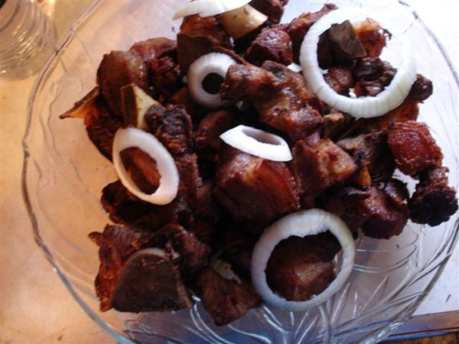
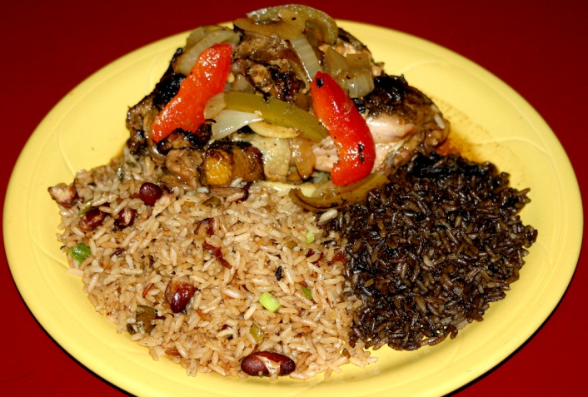
Common Dishes (Yum)
Diri Rice
Diri ak pois Rice and Beans
Legumes Vegetables
Sauce-pois Bean sauce
Grio Fried Pork

Slide 12
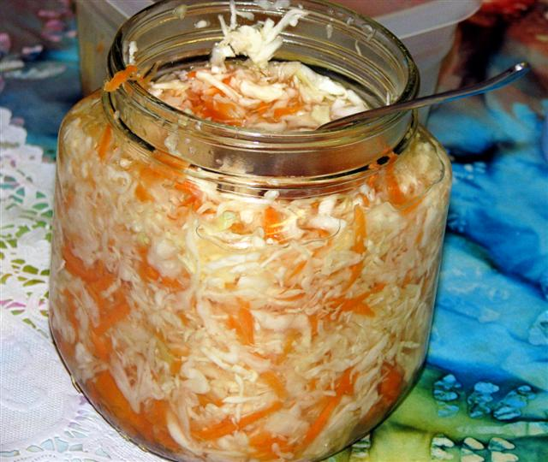
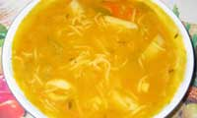
Common Dishes…cont.
Djon djon Mushroom
Pikliz Spice
Kabrit Goat
Soup Joumou Pumpkin Soup
Mais moulen Yellow Grits

Slide 13
Haitian Proverbs
Sak vid pa kanp. An empty sack can't stand up.
Kreyol pale, kreyol komprann. Creole spoken is creole understood
Manman pa janm mode pitit li jouk nan zo. A mother never bites her child to the bone.
Woch nan dio pa konnen doule woch nan soley. The rock in the water does not know the pain of the rock in the sun.
Sa k rive koukouloulou a, ka rive kakalanga tou. What happens to the turkey can happen to the rooster too.

Slide 14
Haitian Translation Websites
http://www.kreyol.com/dictionary/creole-phrases.html
http://www.travelinghaiti.com/haitian_kreyol.asp
http://haitianproverbs.com/

